Slide 1




PDS
Computer Vision
Chapter 5-3:
Multilayer Perceptron
https://github.com/siagianp
https://github.com/amelcharolinesgn2/IoT_simulator-mqtt-NodeRed
https://www.youtube.com/@AmelOline/videos
Notes:
https://medium.com/buildpiper/simplifying-containerization-with-docker-run-command-2f74e114f42a
https://github.com/IBA-Group-IT/IoT-data-simulator
https://www.bevywise.com/blog/docker-mqtt-broker-easy-service-manageability/

Slide 2
What is Multilayer Perceptron NN?
^{W}11
x
^{V}11
^{V}12
.
.
1
^{W}12
.
.
y₁
x₂
y₂
x₃
^{W}34
^{V}42
Input Layer
Hidden Layer
Output Layer

Slide 3
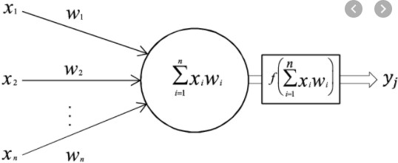

Multilayer Perceptron
i₁
^{W}11
x
^{V}11
^{V}12
.
.
1
^{W}12
.
.
y₁
i₂
h₁
x₂
y₂
i₃
x₃
^{W}34
^{V}42
Perceptron
Input Layer Hidden Layer
Output Layer
For a given node I, the perceptron is defined as weighted summation of the incoming data from the nodes of the previous layer.
𝑝_{𝑖} = 𝑥₀𝑤_{0𝑖} + 𝑥₂𝑤_{2𝑖}+…+ 𝑥_{𝑛}𝑤_{𝑛𝑖} =
$$\sum_{j=1}^{n}{}$$
^{𝑥}𝑗^{𝑤}𝑗
𝑗=1

Slide 4



Multilayer Perceptron
i₁
^{W}11
x
^{V}11
^{V}12
.
.
1
^{W}12
.
.
y₁
i₂
h₁
x₂
y₂
i₃
x₃
^{W}34
^{V}42
Activation
Function
Input Layer
Hidden Layer
Output Layer

Slide 5

Forward Pass
Input Vector
0.2
X₁=1
0.1
1
0
1
0.5
.
.
0.2
.
.
y₁
X₂=0
y₂
X₃=1
0.25
0.15
Input Layer
Hidden Layer
Output Layer

Slide 6
Forward Pass
0.2
X₁=1
0.1
0.5
.
.
x=Perceptron(x)
0.2
.
.
y₁
Linear Activation function
x=f(x)
X₂=0
y₂
X₃=1
0.25
0.15
Input Layer
Hidden Layer
Output Layer
1
0
1

Slide 7
Forward Pass
1x0.2 + 0x1.5 + 1x0.5= 0.7
0.2
X₁=1
0.1
Sigmoid Activation function
f(0.7)=0.668
1.5
.
.0.5
0.2
.
.
y₁
X₂=0
y₂
X₃=1
0.25
0.15
Input Layer
Hidden Layer
Output Layer
1
0
1

Slide 8
Forward Pass
0.2
X₁=1
0.1
0.5
.
.
0.2
.
.
y₁
X₂=0
y₂
X₃=1
0.25
0.15
Input Layer
Hidden Layer
Output Layer
1
0
1
0.668
0.912
0.102
0.471

Slide 9
Forward Pass
0.2
X₁=1
0.1
0.5
.
.
0.2
.
.
y₁
0.812
X₂=0
y₂
0.151
X₃=1
0.25
0.15
Input Layer
Hidden Layer
Output Layer
1 |  | 0.668 |  | 0.812
0 |  | 0.912 |  | 0.151
1 |  | 0.102
 |  | 0.471

Slide 10
Weight Matrix
^{W}11
^{W}12
.
.
h₁
x
i₁
^{V}11
1
V
h₂
.
.
12
o₁
y₁
x₂
i₂
h₃
o₂
y₂
x₃
i₃
^{W}34
^{V}42
h₄
h₁
h₂ h₃
o₁
o₂
i₁ i₂
i₃
h
4
h₁
^{W11 W}12 ^{W}13 ^{W}14
^{W21 W}22 ^{W}23 ^{W}24
^{W31 W}32 ^{W}33 ^{W}34
h
2
h₃ h₄
W
V

Slide 11
Forward Pass
𝒑_{𝟏} = 𝒙_{𝟏}𝑾_{𝟏𝟏} + 𝒙_{𝟐}𝑾_{𝟐𝟏} + 𝒙_{𝟑}𝑾_{𝟑𝟏}
𝒉_{𝟏} = 𝑺𝒊𝒈𝒎𝒐𝒊𝒅(𝒑_{𝟏})
0.2
h₁
X₁=1
0.1
i₁
0.5
.
.
0.2
.
.
h₂
o₁
y₁
X₂=0
i₂
h₃
o₂
y₂
X₃=1
i₃
0.25
0.15
h₄
h₁
h₂ h₃
h₄
h₁
h₂ h₃
h₄
i₁ i₂
i₃
1 0 1
X
=
0.668
W

Slide 12
Forward Pass
𝒑_{𝟐} = 𝒙_{𝟏}𝑾_{𝟏𝟐} + 𝒙_{𝟐}𝑾_{𝟐𝟐} + 𝒙_{𝟑}𝑾_{𝟑𝟐}
𝒉_{𝟐} = 𝑺𝒊𝒈𝒎𝒐𝒊𝒅(𝒑_{𝟐})
0.2
X₁=1
0.1
0.5
.
.
0.2
.
.
y₁
X₂=0
y₂
X₃=1
0.25
0.15
h₁
h₂ h₃
h₄
h₁
h₂ h₃
h₄
i₁ i₂
i₃
1 0 1
X
=
0.668 0.912
W

Slide 13

Forward Pass
0.2
X₁=1
0.1
0.5
.
.
0.2
.
.
y₁
X₂=0
y₂
X₃=1
0.25
0.15
h₁
h₂ h₃
h₄
h₁
h₂ h₃
h₄
i₁ i₂
i₃
1 0 1
X
=
0.668 0.912 0.102 0.471
W

Slide 14
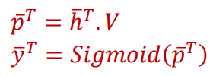

Forward Pass
0.2
X₁=1
0.1
0.5
.
.
0.2
.
.
y₁
X₂=0
y₂
X₃=1
0.25
0.15
o₁
o₂
0.668 0.912 0.102 0.471
_{X} h₁
h₂
h₃
h₄
=
0.812 0.151
V

Slide 15

Forward Pass
0.2
X₁=1
0.1
0.5
.
.
0.2
.
.
y₁
0.812
X₂=0
y₂
0.151
X₃=1
0.25
0.15

Slide 16
PDS
Computer Vision
Chapter 5-4:
Learning the parameters :
Backpropagation through time
https://github.com/siagianp
https://github.com/amelcharolinesgn2/IoT_simulator-mqtt-NodeRed
https://www.youtube.com/@AmelOline/videos
Notes:
https://medium.com/buildpiper/simplifying-containerization-with-docker-run-command-2f74e114f42a
https://github.com/IBA-Group-IT/IoT-data-simulator
https://www.bevywise.com/blog/docker-mqtt-broker-easy-service-manageability/

Slide 17
What is loss function?
What are the parameters of a multilayer perceptron neural network?
How to estimate parameters using backpropagation through time?

Slide 18
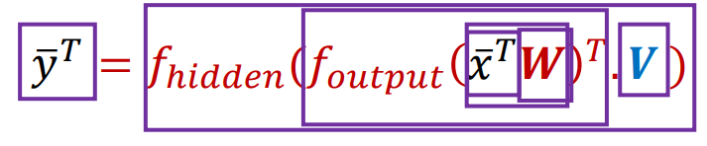
What are the parameters?
 | ^{W}11 ^{W}12 . . ^{W}33
X₁=1
X₂=0
X₃=1
V
11
^{V}12
.
.
y₁
y₂
^{V}11

Slide 19
What are the parameters?
^{W}11 ^{W}12
.
.
^{W}33
^{V}11 ^{V}12
.
.
^{V}11
X₁=1
y₁
X₂=0
y₂
X₃=1
h₁
h₂ h₃
o₁
o₂
i₁ i₂
i₃
h
4
h₁ h₂ h₃
h₄
^{V}11 V12
^{V}21 V22
^{V}31 V32
^{V}41 V42
^{W11 W}12 ^{W}13 ^{W}14
^{W21 W}22 ^{W}23 ^{W}24
^{W31 W}32 ^{W}33 ^{W}34
W
V

Slide 20
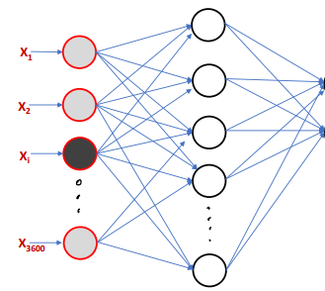
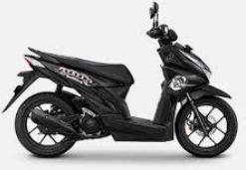

60x60=3600

Slide 21
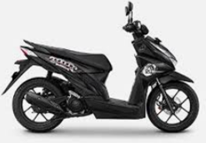
CORRECT
0.812
0.151
60x60=3600

Slide 22


WRONG 0.151
X₁
X₂
0.812
60x60=3600
X_{i}
^{X}3600

Slide 23
Why there is an error in prediction?
Wrong weights Wrong weights
0.2
0.5
.
.
0.25
0.1
0.2
.
.
0.15
X₁=1
Observed
y₁
0.151
0.812
X₂=0
y₂
^{X}3600⁼¹
𝑦

Slide 24
X₁
Observed
Ground Truth
0.151
0.812
1
0
X₂
60x60=3600 X_{i}
𝑦
>
𝑦
There is an error
^{X}3600
Also known as loss

Slide 25
Backpropagation Through Time
0.2
X₁=1
0.1
0.5
.
.
0.2
.
.
y₁
Minimize the Loss function
X₂=0
y₂
X₃=1
0.25
0.15

Slide 26
Backpropagation Through Time
Minimize the Loss function
0.2
X₁=1
0.1
0.5
.
.
0.2
.
.
y₁
X₂=0
y₂
X₃=1
0.25
0.15

Slide 27
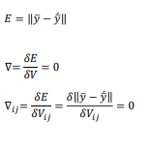
Backpropagation Through Time
Minimize the Loss function
0.2
X₁=1
0.1
0.5
.
.
0.2
.
.
y₁
X₂=0
y₂
X₃=1
0.25
0.15

Slide 28
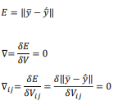
Backpropagation Through Time
Minimize the Loss function
0.2
X₁=1
0.1
0.5
.
.
0.2
.
.
y₁
X₂=0
𝛿𝐸
∇= _{𝛿𝑉} = 0
y₂
X₃=1
0.25
0.15
_{𝑉}𝑡
= 𝑉^{𝑡−1} + 𝜂 ∇^{𝑡}
𝑖𝑗 𝑖𝑗
𝑖j
𝜼 = [𝟎, 𝟏]

Slide 29

Backpropagation Through Time
0.2
X₁=1
0.1
0.5
.
.
0.2
.
.
y₁
X₂=0
y
2
X₃=1
0.25
0.15

Slide 30

Backpropagation Through Time
0.2
X₁=1
0.1
0.5
.
.
0.2
.
.
y₁
X₂=0
y
2
X₃=1
0.25
0.15

Slide 31
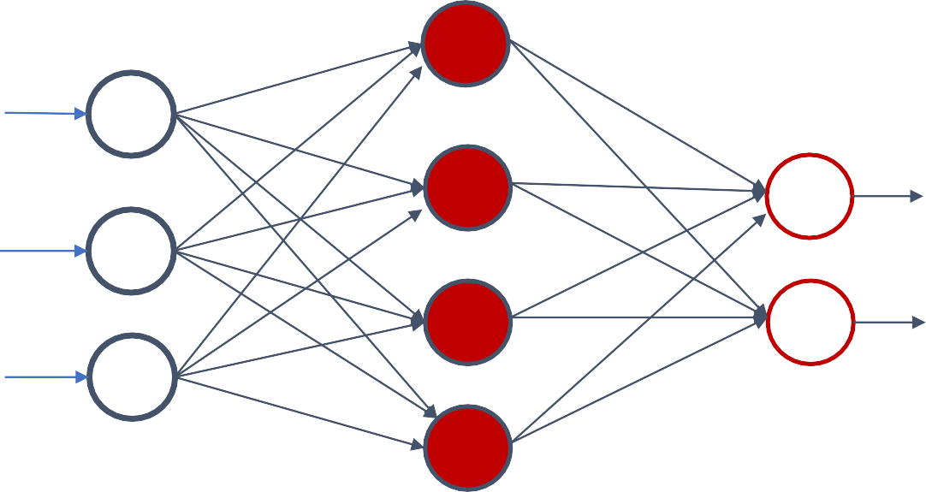

Backpropagation Through Time
0.2
X₁=1
0.1
0.5
.
.
0.2
.
.
y₁
X₂=0
y
2
X₃=1
0.25
0.15

Slide 32
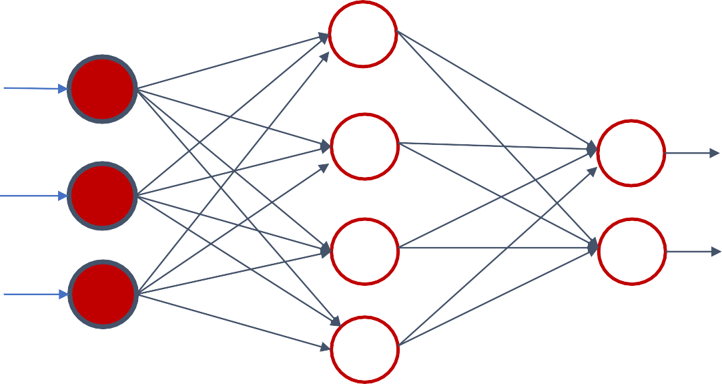

Backpropagation Through Time
0.2
X₁=1
0.1
0.5
.
.
0.2
.
.
y₁
X₂=0
y
2
X₃=1
0.25
0.15

Slide 33
How are the Derivatives performed Loss function
0.2
𝛿𝐸
∇= _{𝛿𝑉} = 0
X₁=1
0.1
0.5
.
.
0.2
.
.
y₁
𝛿𝐸
X₂=0
∇ =
= 0
11
𝛿𝑉
11
y₂
X₃=1
0.25
0.15

Slide 34

How are the Derivatives performed
Loss function
0.2
𝛿𝐸
∇= _{𝛿𝑉} = 0
X₁=1
0.1
0.5
.
.
0.2
.
.
y₁
𝛿𝐸
X₂=0
∇ =
= 0
11
𝛿𝑉
11
y₂
X₃=1
0.25
0.15

Slide 35
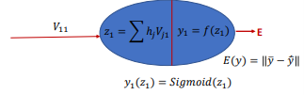
How are the Derivatives performed
Loss function
0.2
𝛿𝐸
∇= _{𝛿𝑉} = 0
X₁=1
0.1
0.5
.
.
0.2
.
.
y₁
𝛿𝐸
X₂=0
∇ =
= 0
11
𝛿𝑉
11
y₂
X₃=1
0.25
0.15
𝑧₁(𝑉₁₁) = ℎ₁𝑉₁₁ + ℎ₂𝑉₂₁ + ℎ₃𝑉₃₁ + ℎ₄𝑉₄₁

Slide 36

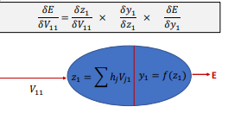
How are the Derivatives performed Loss function
0.2
X₁=1
0.1
0.5
.
.
0.2
.
.
y₁
X₂=0
y₂
X₃=1
0.25
0.15
𝛿𝐸
𝛿𝑧₁ 𝛿𝑦₁ 𝛿𝐸
∇₁₁= _{𝛿𝑉}
11
⁼ 𝛿𝑉 . 𝛿𝑧 . 𝛿𝑦
11 1 1
𝑧₁ = ℎ₁𝑉₁₁ + ℎ₂𝑉₂₁ + ℎ₃𝑉₃₁ + ℎ₄𝑉₄₁
𝑦₁ = 𝑆𝑖𝑔𝑚𝑜𝑖𝑑(𝒛_{𝟏})

Slide 37
Backpropagation
Loss function
0.2
𝛿𝐸
∇= _{𝛿𝑊} = 0
X₁=1
0.1
0.5
.
.
0.2
.
.
y₁
𝛿𝐸
X₂=0
∇ =
= 0
𝑖𝑗
𝛿𝑊
𝑖𝑗
y₂
X₃=1
0.25
0.15
𝛿𝐸
𝛿𝑎_{1 ×}
𝛿ℎ₁
𝛿𝑎
𝛿𝑧₁
𝛿ℎ
𝛿𝑦₁
𝛿𝑧
𝛿𝐸
𝛿𝑦
×
×
×
𝛿𝑊 ⁼ 𝛿𝑊
11 11
1
1
1
1
𝑧₁ = ෍ ℎ_{𝑗}𝑉_{𝑗1}
𝑦₁ = 𝑓(𝑧₁)
E
𝑎₁ = ෍ 𝑥_{𝑖}𝑊_{𝑖1} ^{ℎ}1 ^{= 𝑓(𝑎}1⁾
𝑉
^{𝑊}11
11

Slide 38
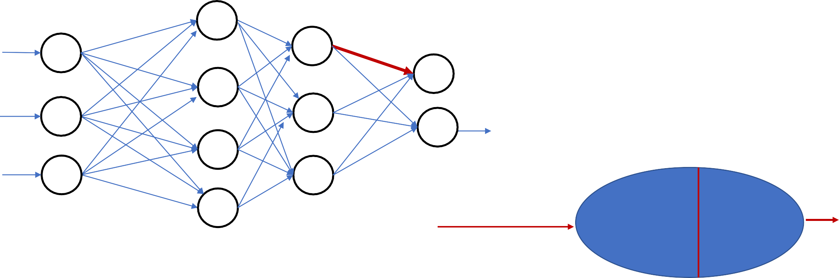
We may have multiple layers.
X₁
X₂
X₃
V
U
W
𝑧₁ = ෍ ℎ_{𝑗}𝑉_{𝑗1}
𝑦₁ = 𝑓(𝑧₁)
E
^{𝑉}11
𝛿𝐸
𝛿𝑧_{1 ×}
𝛿𝑦₁
𝛿𝑧
𝛿𝐸
×
𝛿𝑉 ⁼ 𝛿𝑉
11 11
1
𝛿𝑦
1

Slide 39
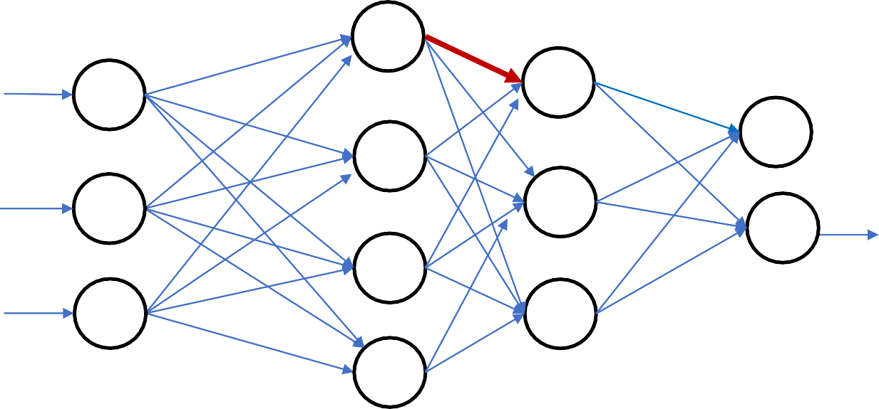
We may have multiple layers
X₁
X₂
X₃
V
U
W
𝛿𝐸
𝛿𝑎_{1 ×}
𝛿ℎ₁
𝛿𝑎
𝛿𝑧₁
𝛿ℎ
𝛿𝑦₁
𝛿𝑧
𝛿𝐸
𝛿𝑦
×
×
×
𝛿𝑊 ⁼ 𝛿𝑊
11 11
1
1
1
1
𝑧₁ = ෍ ℎ_{𝑗}𝑉_{𝑗1}
𝑦₁ = 𝑓(𝑧₁)
𝑎₁ = ෍ 𝑥_{𝑖}𝑊_{𝑖1} ^{ℎ}1 ^{= 𝑓(𝑎}1⁾
𝑉
^{𝑊}11
11

Slide 40
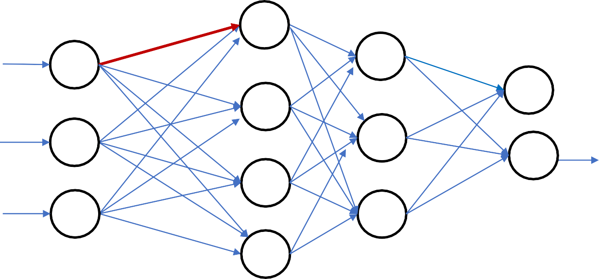
We may have multiple layers
X₁
X₂
X₃
V
U
W
𝛿𝐸
𝛿𝑏_{1 ×} 𝛿𝑔₁
1
𝛿𝑎₁
𝛿𝑔
𝛿ℎ₁
𝛿𝑎
𝛿𝑧₁
𝛿ℎ
𝛿𝑦₁
𝛿𝑧
𝛿𝐸
𝛿𝑦
×
×
×
×
×
𝛿𝑈 ⁼ 𝛿𝑈
𝛿𝑏
11 11
1
1
1
1
1
𝑧₁ = ෍ ℎ_{𝑗}𝑉_{𝑗1}
𝑦₁ = 𝑓(𝑧₁)
𝑏₁ = ෍ 𝑥_{𝑖}𝑈_{𝑖1}
𝑔₁ = 𝑓(𝑏₁)
𝑎₁ = ෍ 𝑔_{𝑖}𝑊_{𝑖1} ^{ℎ}1 ^{= 𝑓(𝑎}1⁾
𝑉
𝑈
^{𝑊}11
11
11

Slide 41
PDS
Computer Vision
Chapter 5-5:
Learning with different Loss Functions and Their Derivatives
https://github.com/siagianp
https://github.com/amelcharolinesgn2/IoT_simulator-mqtt-NodeRed
https://www.youtube.com/@AmelOline/videos
Notes:
https://medium.com/buildpiper/simplifying-containerization-with-docker-run-command-2f74e114f42a
https://github.com/IBA-Group-IT/IoT-data-simulator
https://www.bevywise.com/blog/docker-mqtt-broker-easy-service-manageability/

Slide 42
Two Commonly used Loss Functions are
Mean Square Error – Standard Loss Function for Regression
Cross Entropy Loss - Standard Loss Function for Classification

Slide 43
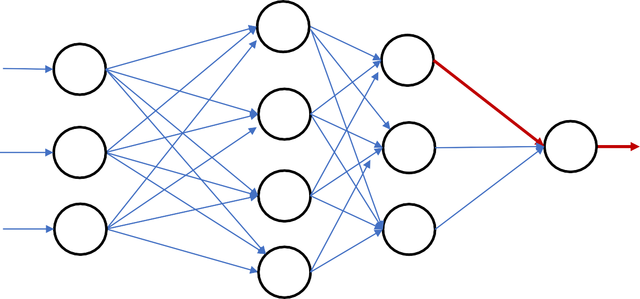
Mean Square Error (MSE)
For the Single Sample
X₁
𝑉₁
Ground truth is
𝑦
X₂
y
X₃
V
U
W

Slide 44

Mean Square Error (MSE)
For the Single Sample
X₁
𝑉₁
Ground truth is
𝑦
X₂
y
X₃
V
U
W
𝑧 = ෍ ℎ_{𝑗}𝑉_{𝑗}
𝑦 = 𝑓(𝑧)
E
𝛿𝐸
𝛿𝑧
𝛿𝑦
𝛿𝑧 ×
𝛿𝐸
𝛿𝑦
×
𝑉₁
𝛿𝑉 ⁼ 𝛿𝑉
1 1

Slide 45

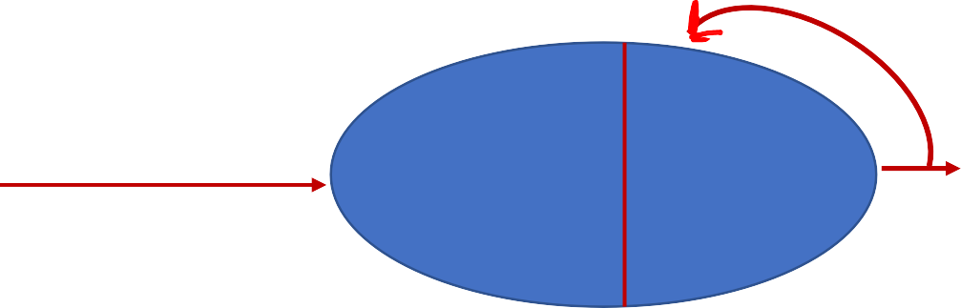
Mean Square Errors
For the Single Sample
X₁
𝑉₁
Ground truth is 𝑦
X₂
y
𝛿𝐸 𝛿(𝑦 − 𝑦ƴ )
𝛿𝑦 ⁼
2
= 2(𝑦 − 𝑦ƴ )
𝛿𝑦
X₃
V
U
W
𝑧 = ෍ ℎ_{𝑗}𝑉_{𝑗}
𝑦 = 𝑓(𝑧)
E
𝛿𝐸
𝛿𝑧
𝛿𝑦
𝛿𝑧 ×
𝛿𝐸
𝛿𝑦
×
𝑉₁
𝛿𝑉 ⁼ 𝛿𝑉
1 1

Slide 46


Mean Square Errors
If the ground truth is 𝑦
For n Samples
X₁
𝑉₁
𝑛
1
𝐸 = ෍(𝑦^{𝑖} − 𝑦ƴ ^{𝑖})²
X₂
y
𝑛
𝑖=1
X₃
V
𝛿𝐸
𝛿 ¹ σ^{𝑛} (𝑦^{𝑖} − 𝑦ƴ ^{𝑖})²
2
𝑛
U
=
𝑛
𝑖=1
= ෍ (𝑦^{𝑖} − 𝑦ƴ ^{𝑖})
W
𝛿𝑦
𝛿𝑦
𝑛
𝑖=1
𝑧 = ෍ ℎ_{𝑗}𝑉_{𝑗}
𝑦 = 𝑓(𝑧)
E
𝛿𝐸
𝛿𝑧
𝛿𝑦
𝛿𝑧 ×
𝛿𝐸
𝛿𝑦
×
𝑉₁
𝛿𝑉 ⁼ 𝛿𝑉
1 1

Slide 47
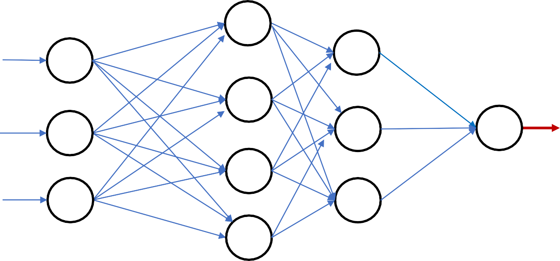
Mean Square Errors
If the ground truth is 𝑦
For n Samples
X₁
𝑛
1
𝐸 = ෍(𝑦^{𝑖} − 𝑦ƴ ^{𝑖})²
X₂
y
𝑛
𝑖=1
X₃
V
𝛿𝐸
𝛿 ¹ σ^{𝑛} (𝑦^{𝑖} − 𝑦ƴ ^{𝑖})²
2
𝑛
U
=
𝑛
𝑖=1
= ෍ (𝑦^{𝑖} − 𝑦ƴ ^{𝑖})
W
𝛿𝑦
𝛿𝑦
𝑛
𝑖=1
Backpropagation will be done after a batch of n Samples

Slide 48
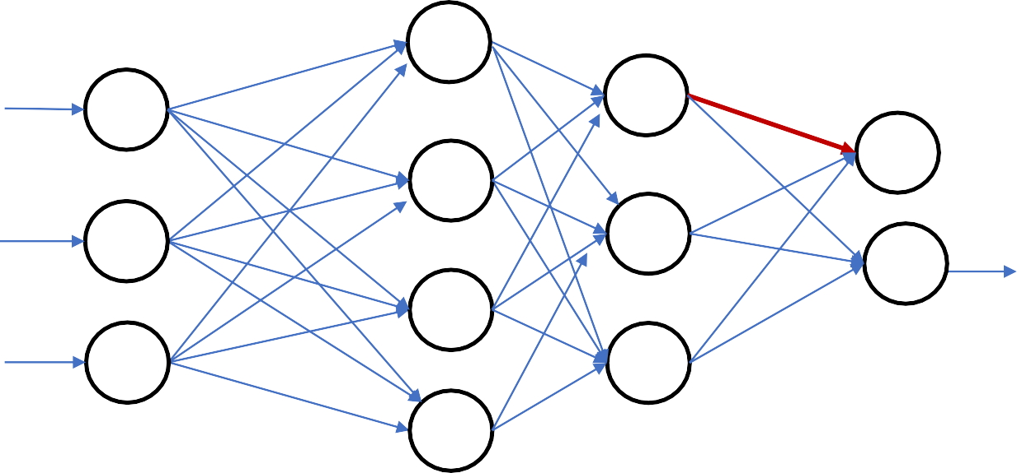
Mean Square Errors
If the ground truth is 𝑦
^{𝑉}11
For the n Sample
X₁
𝑛
1
𝑬 = ෍(𝒚^{𝑖} − 𝒚ƴ ^{𝑖})²
X₂
𝑛
𝑖=1
X₃
V
𝛿𝑬
𝛿 ¹ σ^{𝑛} (𝒚^{𝑖} − 𝒚ƴ ^{𝑖})²
2
𝑛
U
=
𝑛
𝑖=1
= ෍ (𝑦
^{𝑖} − 𝑦ƴ ^{𝑖})
W
𝛿𝑦₁
𝛿𝑦₁
𝑛
1
1
𝑖=1
𝑧₁ = ෍ ℎ_{𝑗}𝑉_{𝑗1}
𝑦₁ = 𝑓(𝑧₁)
E
𝛿𝐸
𝛿𝑧_{1 ×}
𝛿𝑦₁
𝛿𝑧
𝛿𝑬
×
^{𝑉}11
𝛿𝑉 ⁼ 𝛿𝑉
11 11
1
𝛿𝑦
1

Slide 49
Let us illustrate with a toy example

Slide 50






0.2
X₁
0.1
0.5
0.2
#Wheel
Height Weight
y₁
4 | 6 | 500
4 | 5.5 | 600
4 | 5 | 550
2 | 3 | 200
2 | 3.5 | 150
2 | 4 | 250
X₂
y₂
X₃
0.25
0.15

Slide 51
0.2
4
0.1
0.5
𝑦
0.9
𝑦
1
0.2
#Wheel Height Weight
4 6 500
6
0.1
0
4 | 5.5 | 600
4 | 5 | 550
2 | 3 | 200
2 | 3.5 | 150
2 | 4 | 250
500
0.25
0.15

Slide 52
0.2
4
0.1
0.5
𝑦
0.9
𝑦
1
0.2
#Wheel
Height Weight
4 | 6 | 500
4 | 5.5 | 600
4 | 5 | 550
2 | 3 | 200
2 | 3.5 | 150
2 | 4 | 250
6
0.1
0
500
0.25
0.15
Error 𝐸 = (𝑦 − 𝑦ƴ )²
Error 𝐸_{𝑦} = (0.9 − 1)²= 0.01
1
Error 𝐸_{𝑦} = (0.1 − 0)²= 0.01
2
If these errors are not acceptable, then Backpropagate.

Slide 53
0.2
4
0.1
0.5
0.2
#Wheel
Height Weight
0.6
1
4 | 6 | 500
4 | 5.5 | 600
4 | 5 | 550
2 | 3 | 200
2 | 3.5 | 150
2 | 4 | 250
5.5
0.4
0
600
0.25
0.15
Error 𝐸 = (𝑦 − 𝑦ƴ )²
Error 𝐸_{𝑦} = (0.6 − 1)²= 0.16
1
Error 𝐸_{𝑦} = (0.4 − 0)²= 0.36
2
If these errors are not acceptable, then Backpropagate.

Slide 54
0.2
0.1
2
0.5
0.2
#Wheel
Height Weight
0.6
1
4 | 6 | 500
4 | 5.5 | 600
4 | 5 | 550
2 | 3 | 200
2 | 3.5 | 150
2 | 4 | 250
4
0.4
0
250
0.25
0.15
One complete cycle of training is called Epoch

Slide 55
0.2
0.1
2
0.5
0.2
#Wheel
Height Weight
0.6
1
4 | 6 | 500
4 | 5.5 | 600
4 | 5 | 550
2 | 3 | 200
2 | 3.5 | 150
2 | 4 | 250
4
0.4
0
250
0.25
0.15
Backpropagation after every sample is expensive.
Do it in batches.

Slide 56
PDS
Computer Vision
Chapter 5-6:
Activation Functions and Their Derivatives
https://github.com/siagianp
https://github.com/amelcharolinesgn2/IoT_simulator-mqtt-NodeRed
https://www.youtube.com/@AmelOline/videos
Notes:
https://medium.com/buildpiper/simplifying-containerization-with-docker-run-command-2f74e114f42a
https://github.com/IBA-Group-IT/IoT-data-simulator
https://www.bevywise.com/blog/docker-mqtt-broker-easy-service-manageability/

Slide 57
Characteristics of different Activation Functions and their gradient
The choice of activation function depend on the nature of the problem, nature of the target output and the deepness of the network.

Slide 58
Activation Functions
i₁
Activation Function is applied over the linear weighted summation of the incoming information to a node.
Convert linear input signals from perceptron to
a linear/non-linear output signal.
It decides whether to activate a node or not.
i₂
h₁
i₃
Activation Function

Slide 59
Activation Functions
i₁
i₂
h₁
Activation functions must be monotonic, differentiable, and quickly converging.
i₃
Types of Activation Functions:
Linear
Non-Linear
Activation Function

Slide 60
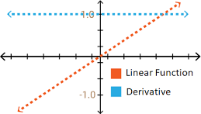
Linear
𝑓 𝑥 = 𝑎𝑥 + 𝑏
𝑑𝑓(𝑥)
= 𝑎
𝑑𝑥
Observations:
Constant gradient
Gradient does not depend on the change in the input

Slide 61
Linear
𝑓 𝑥 = 𝑎𝑥 + 𝑏
𝑓 𝑥
= 𝑎₁𝑥₁ + 𝑎₂𝑥₂ + 𝑎₃𝑥₃ + ⋯ + 𝑏

Slide 62
Linear
i₁
i₂
h₁
𝑓 𝑥 = 𝑎𝑥 + 𝑏
i₃
𝑓 𝑥
= 𝑎₁𝑥₁ + 𝑎₂𝑥₂ + 𝑎₃𝑥₃ + ⋯ + 𝑏
Perceptron

Slide 63
Non-Linear
Sigmoid (Logistic)
Hyperbolic Tangent (Tanh)
Rectified Linear Unit (ReLU)
Leaky Relu
Parametric Relu
Exponential Linear Unit (ELU)

Slide 64
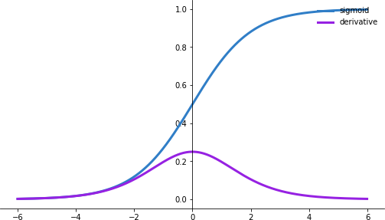
Sigmoid Activation Functions (Logistics)
1
𝑓 𝑥
=
1 + 𝑒^{−𝑥}
𝑑𝑓(𝑥)
= 𝑓 𝑥 (1 − 𝑓(𝑥))
𝑑𝑥
Observations:
Output: 0 to 1
Outputs are not zero-centered
Can saturate and kill (vanish) gradients

Slide 65
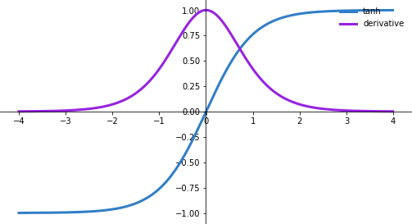
Tanh Activation Function
_{𝑒}𝑥 _{− 𝑒}−𝑥
=
_{𝑒}𝑥 _{+ 𝑒}−𝑥
𝑓 𝑥
𝑑𝑓(𝑥)
= 1 − 𝑓(𝑥)²
𝑑𝑥
Observations:
Output: -1 to +1
Outputs are zero-centered
Can Saturate and kill (vanish) gradients
Gradient is more steeped than Sigmoid, resulting in faster convergence

Slide 66
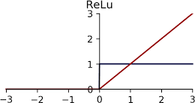
Rectified Linear Unit(ReLU)
𝑓 𝑥 = max(0, 𝑥)
𝑑𝑓(𝑥)
= 1
𝑑𝑥
Observations:
Greatly increase training speed compared to tanh and sigmoid
Reduces likelihood of killing(vanishing) gradient
It can blow up activation
Dead nodes

Slide 67
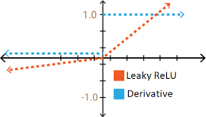
Leaky-ReLU
𝑓 𝑥 = max(0.01𝑥, 𝑥)
𝑑𝑓(𝑥)
_{= ቊ}0.01,
𝑥 < 0
𝑥 ≥ 0
𝑑𝑥
1,
Observations:
Fixed dying ReLU

Slide 68
Parameterized-ReLU
𝑓 𝑥 = max(𝛼𝑥, 𝑥)
𝑑𝑓(𝑥)
𝛼,
𝑥 < 0
𝑥 ≥ 0
= ቊ_{1,}
𝑑𝑥
Observations:

Slide 69
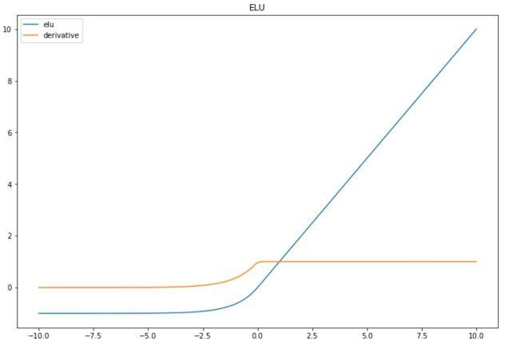
Exponential Linear Unit (ELU)
𝛼(𝑒^{𝑥} − 1), 𝑥 < 0
f(𝑥) = ቊ
1𝑥 𝑥 ≥ 0
𝑑𝑓(𝑥)
_{= ቊ}𝑓 𝑥 + 𝛼,
1,
𝑥 < 0
𝑥 ≥ 0
𝑑𝑥
Observations:
It can produce –ve output
It can blow up activation function

Slide 70
Complete Chain
X₁
y
y’
0.6
0.4
1
0
X₂
X₃
V
U
𝑧₁ = ෍ ℎ_{𝑗}𝑉_{𝑗1}
𝑦₁ = 𝑓(𝑧₁)
E
𝛿𝐸
𝛿𝑧_{1 ×}
𝛿𝑦₁
𝛿𝑧
𝛿𝐸
×
^{𝑉}11
𝛿𝑉 ⁼ 𝛿𝑉
11 11
1
𝛿𝑦
1
14

Slide 71
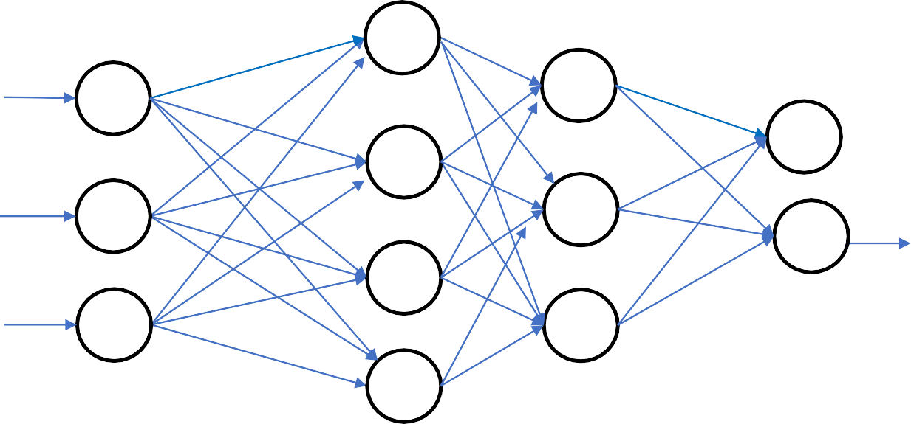
Deep Network
X₁
X₂
X₃
V
U
W
15

Slide 72
Deep Network - Vanishing/Exploding Gradient
X₁
X₂
X₃
V
U
W
𝛿𝐸
𝛿𝑏_{1 ×} 𝛿𝑔₁
1
𝛿𝑎₁
𝛿𝑔
𝛿ℎ₁
𝛿𝑎
𝛿𝑧₁
𝛿ℎ
𝛿𝑦₁
𝛿𝑧
𝛿𝐸
𝛿𝑦
×
×
×
×
×
𝛿𝑈 ⁼ 𝛿𝑈
𝛿𝑏
11 11
1
1
1
1
1
𝑧₁ = ෍ ℎ_{𝑗}𝑉_{𝑗1}
𝑦₁ = 𝑓(𝑧₁)
𝑏₁ = ෍ 𝑥_{𝑖}𝑈_{𝑖1}
𝑔₁ = 𝑓(𝑏₁)
𝑎₁ = ෍ 𝑔_{𝑖}𝑊_{𝑖1} ^{ℎ}1 ^{= 𝑓(𝑎}1⁾
𝑉
𝑈
^{𝑊}11
11
11
16

Slide 73
Thank you!
PDS
SDN
NFV
Computer Vision
Thank you For being a great class!
https://github.com/siagianp
https://github.com/amelcharolinesgn2/IoT_simulator-mqtt-NodeRed
https://www.youtube.com/@AmelOline/videos
Notes:
https://medium.com/buildpiper/simplifying-containerization-with-docker-run-command-2f74e114f42a
https://github.com/IBA-Group-IT/IoT-data-simulator
https://www.bevywise.com/blog/docker-mqtt-broker-easy-service-manageability/

